Slide 2
1
3

Slide 3
900 €

Slide 4
1
2

Slide 5
2
5

Slide 6
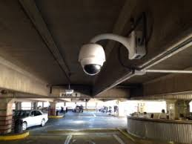
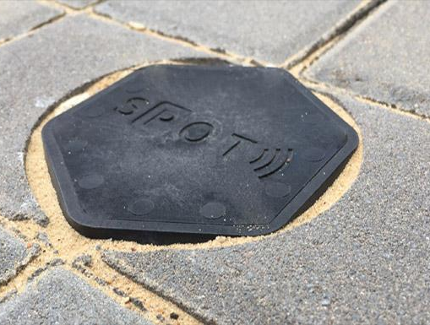

Slide 7


Slide 8
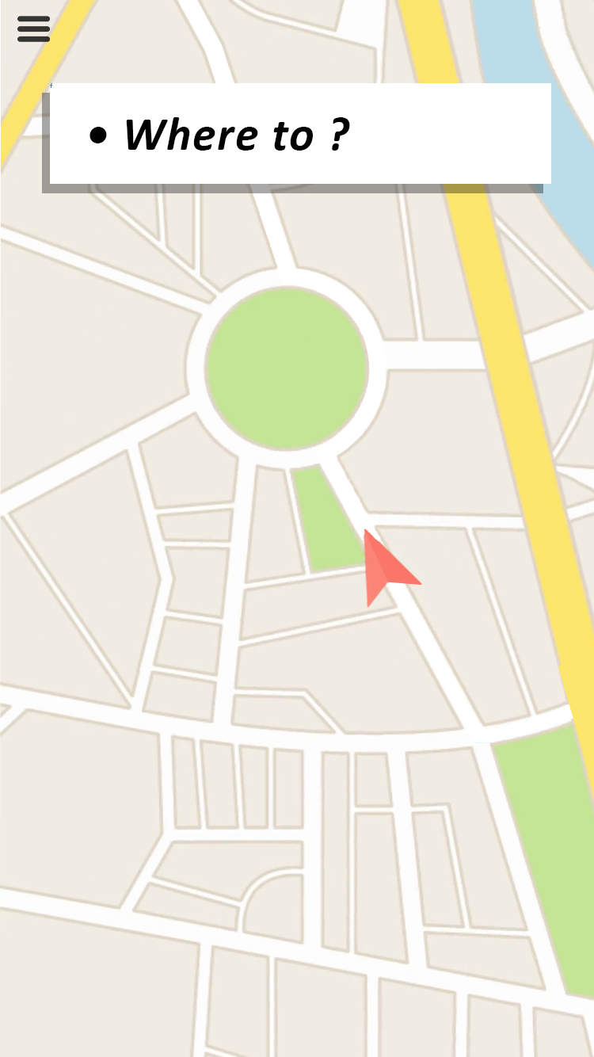
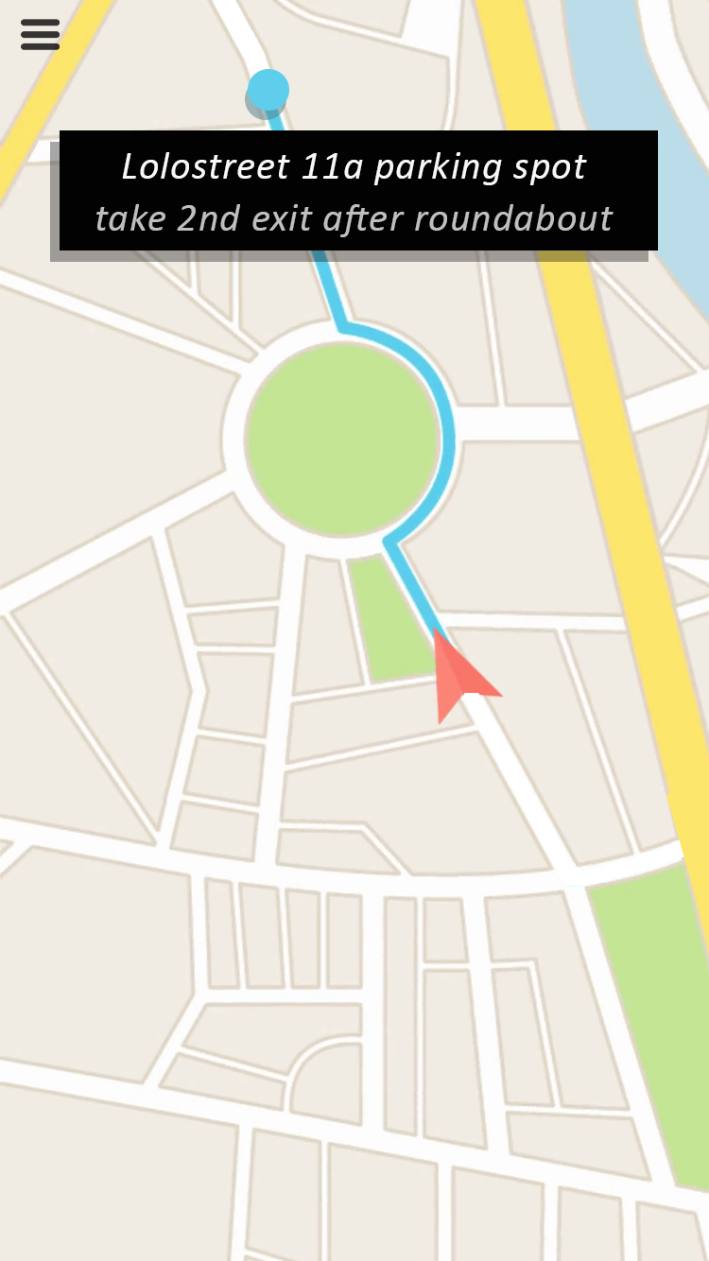
Navigation to vacant on-street parking spots in the city

Slide 9
Percentage of sales model

Slide 10

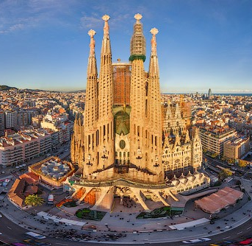

Slide 11
700,000
200,000 500,000

Slide 12
1,200,000

Slide 13
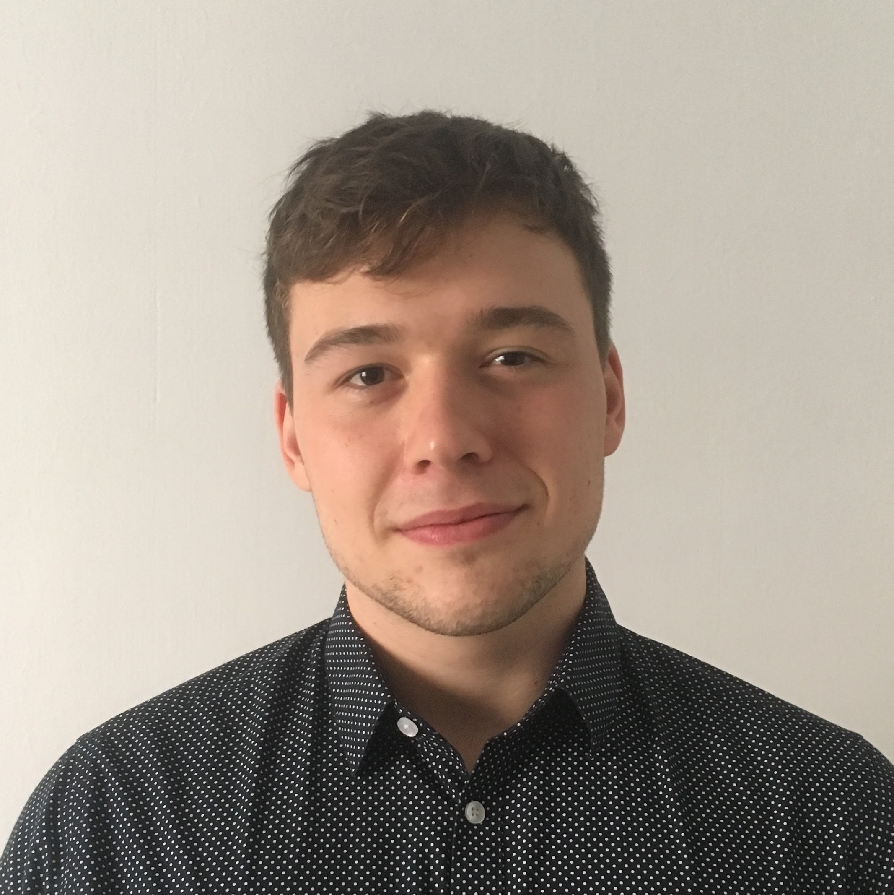
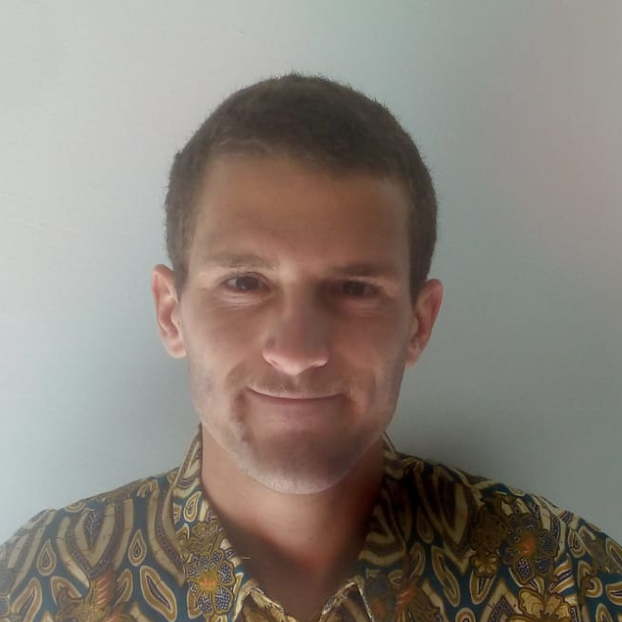


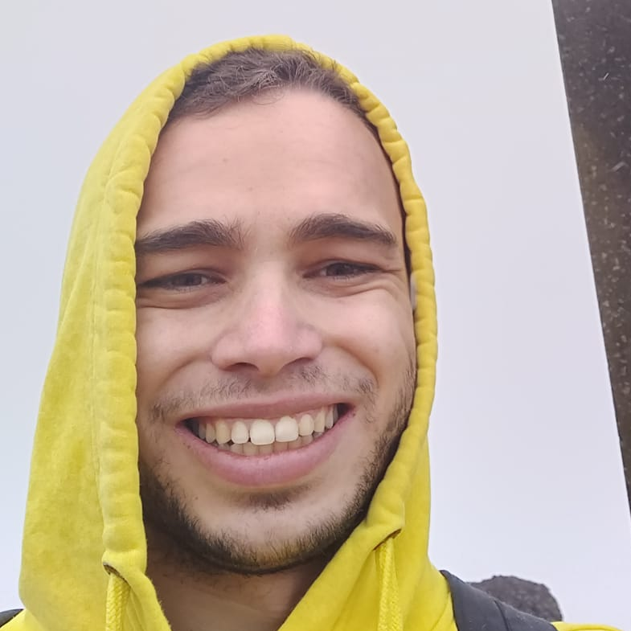
Adam
Bako
Data Scientist & Developer
Lorenzo
Foà
Data scientist &
Sales
Gereltsetseg
Altangerel
Computer networking & Researcher
Marina
Kurokawa
Marketing &
Financing
Ignacio
Aparicio Vázquez
Data Scientist & Computer vision expert

